Slide 1

SPELLING GAME

Slide 2
Problem Statement
Kids get bored while studying and its common to get distracted!Confusion between words, Difficult in remembering the spellings?!One common but mistaken belief is that spelling problems stem from a poor visual memory for the sequences of letters in words, So to help kids with spelling and fun while learning. We should have an application that should take care of all such things.

Slide 3


I wish
somebody could help me….
I’m confused!!

Slide 4


Mom I’m so confused between the words…plzzzz help me!!!
Don’t worry Honey. Here there is a game called spelling game which will help you and makes your learning fun !!☺

Slide 5
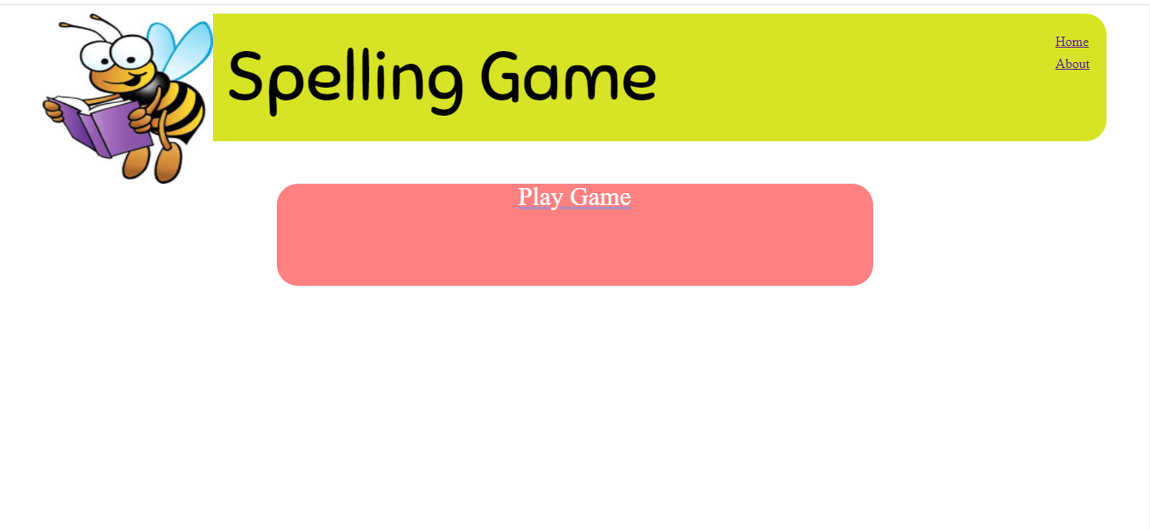
HIGH FIDELITY PROTOTYPE
Index Page

Slide 6
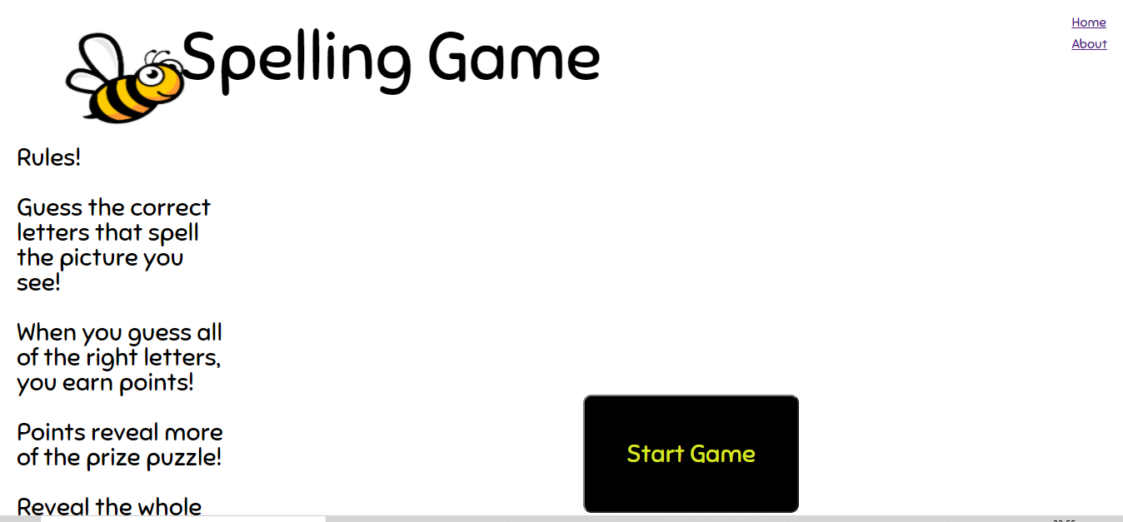
Game Starting

Slide 7
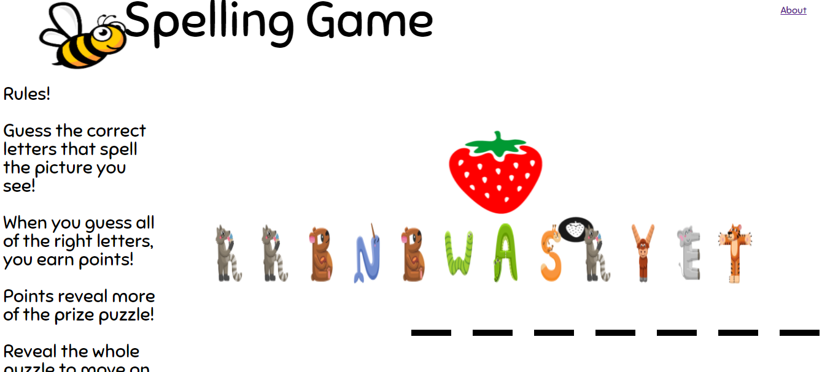
Spelling game

Slide 8
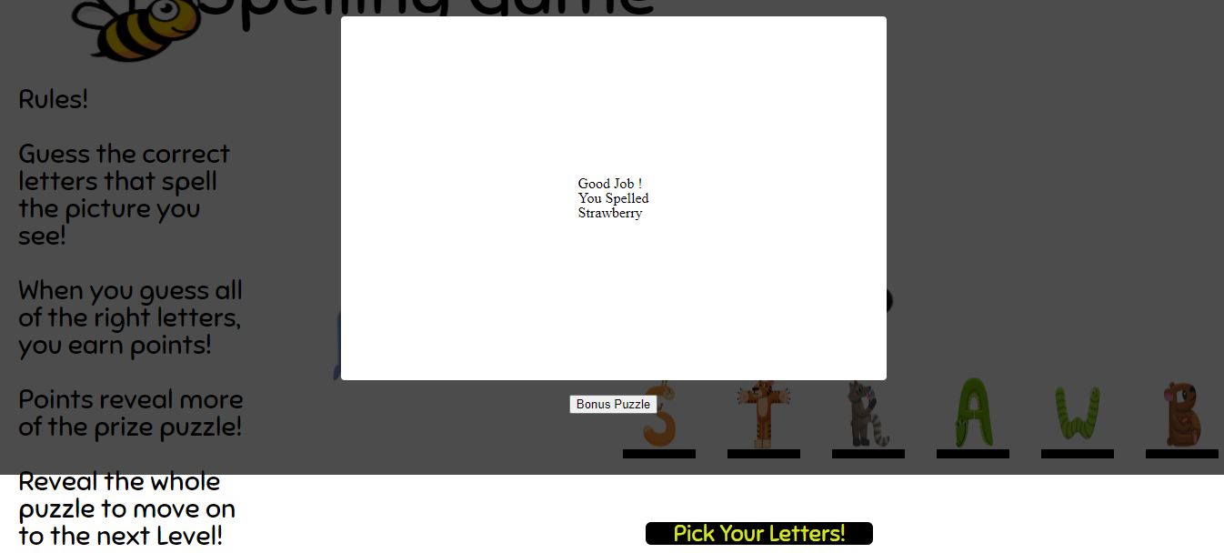
Appreciation after correct selection

Slide 9
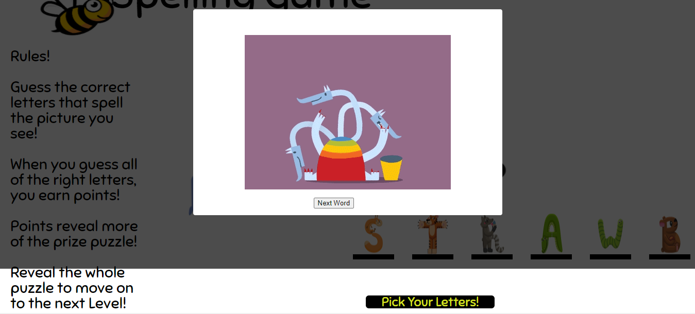
Congratulation after successful attempt

Slide 10
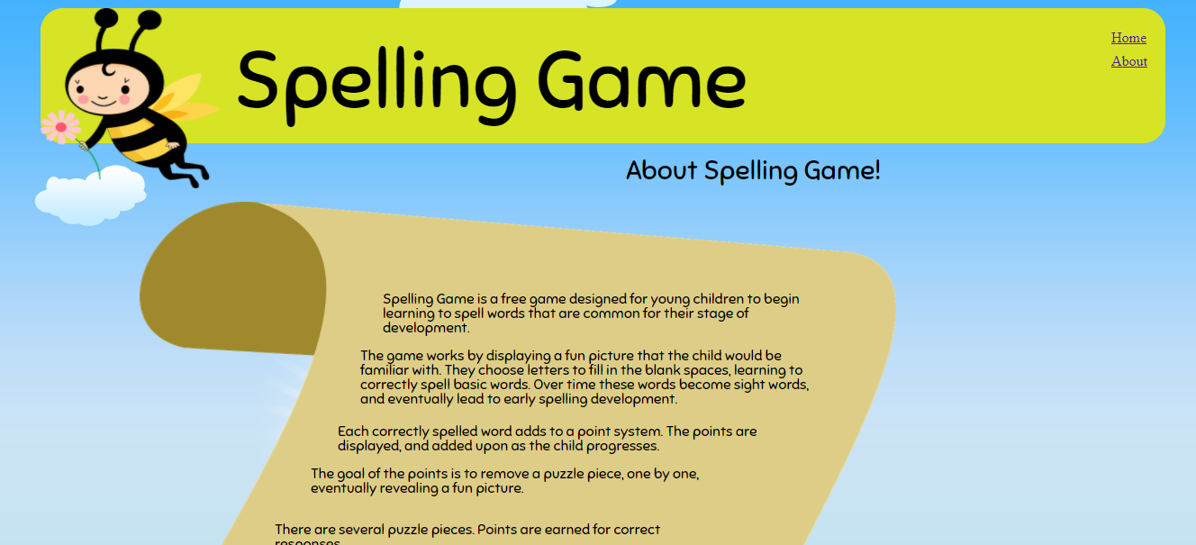
About Game

Slide 11
HEURISTIC EVALUATION
Upon doing the required Heuristics Evaluation, in accordance with the heuristics principles by Nielsen, we have developed a gaming website that is showing the visibility of system status, match between system and the real world and have aesthetic and minimalist design.

Slide 12
We have considered these principles while designing the interfaces:
Visibility of the system status :System outputs appropriate messages or the puzzles.
Match between system and the real world :The system uses real world concepts.
User control and freedom: User has the freedom to choose correct images to form correct spellings.
Recognition rather than recall: Instructions are given to play the games are clear, there is no need for recalling.
Aesthetic and minimalist design: The interface is done with minimalistic and simple way with required information

Slide 13
THANKYOU

